Slide 1


NEXT GEN EMPLOYABILITY PROGRAM
CREATING A FUTURE-READY WORKFORCE
Student Name :
Hiten V Bhanushali
Student ID :
STU62c84351ae2c61657291601
Mobile No:
9028519900
Mail ID:
hittanbhanushali14@gmail.com
College Name :
PCET’s Nutan Maharashtra Institute Of Engineering & Technology, Pune

Slide 2
CAPSTONE PROJECT SHOWCASE
Health Care Data Driven Decisions using Power BI
Abstract | Problem Statement | Project Overview | Proposed Solution | Technology Used | Modelling & Results | Conclusion | Q&A

Slide 3
Abstract
1
This project aims to transform healthcare decision-making by leveraging Power BI-driven data analytics.
2
Anticipating enhanced operational efficiency, improved patient outcomes, and better regulatory compliance.
3
Addressing challenges such as data fragmentation, manual reporting inefficiencies, limited predictive analytics, and the need for strategic decision-making.
4
Enabling our healthcare organization to drive significant improvements in care delivery, resource allocation and overall performance.

Slide 4


Problem Statement
Data Fragmentation: Our healthcare organization struggles with fragmented data sources spread across systems and departments, impeding comprehensive insights into patient outcomes and operational efficiencies.
Limited Predictive Analytics: Without robust predictive analytics capabilities, we cannot forecast patient demand or identify high-risk populations, leading to reactive rather than proactive healthcare delivery.
Strategic Decision Making: The absence of a data-driven approach inhibits informed strategic decision-making, impacting our ability to optimize operations, improve patient care, and ensure regulatory compliance.
Manual Reporting Inefficiencies: Current reporting processes are time-consuming and error-prone, hindering timely access to actionable insights and limiting our ability to allocate resources effectively.

Slide 5

Project Overview
Data Preprocessing – Importing Data, Data Wrangling, Error Correction, Reshaping Data
DAX – Using Data Analytics Expressions(DAX) to create required columns and measures
Data Visualization – Adding Visuals such as Cards, Bar Charts, Decomposition Tree
Formatting & Testing – Formatting the dashboard and testing different visuals

Slide 6
Proposed Solution
Data visualization by means of various visuals like Card Visuals, Decomposition tree, Bar charts, etc
Using DAX to create necessary columns, measures, etc necessary for visualization
Formatting the dashboard for a proper visual effect
Efficient data selection for visualization & further decision making
Use of slicers in order to filter data in real time on basis of important classification factors

Slide 7

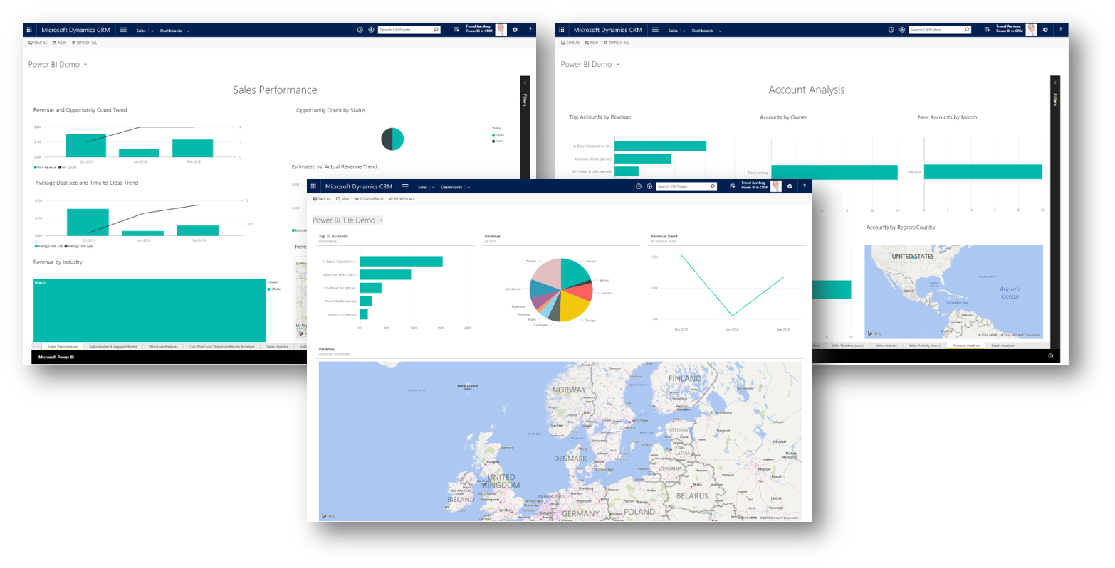
Technology used
This Photo by Unknown Author is licensed under CC BY-SA

Slide 8
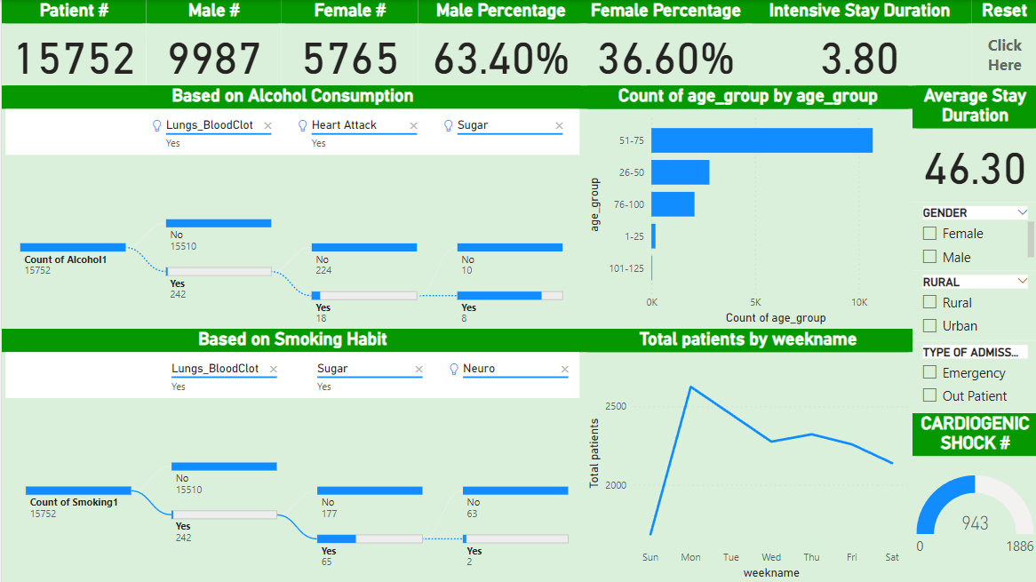
Modelling & Result

Slide 9
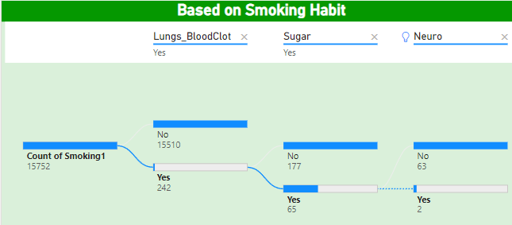
Modelling & Result

Slide 10
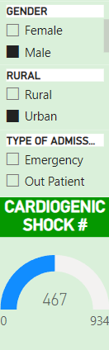
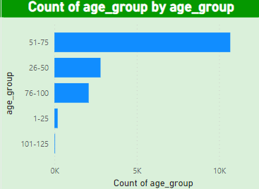
Modelling & Result

Slide 11

Conclusion
Implemented a Data Analytics Dashboard using Power BI
Implemented important visuals required for decision making
Formatted the dashboard for visual effect

Slide 12


Notes:
Thank You !!

